Slide 1
ATAAPS Training
86TH Comptroller Squadron
86CPTS.CIV.PAY@us.af.mil

Slide 2
Agenda
Training Instructions
ATAAPS Timeline
Employee
Certifier
Timekeeper
References
Training Certificate (only Certifier & Timekeeper)

Slide 3
Training Instructions
Please read the ENTIRE Training carefully!
Everyone should be aware of the other Roles Responsibilities.

Slide 4
ATAAPS Timeline
Employee T&A input & concur COB every 2nd Tuesday
Even if you are a certifier ;)
Certification Window is 2nd Tuesday Noon to 2nd Wednesday at Noon
Corrections can be done as of 2nd Friday
Leave is to be input & reviewed by certifier as soon as planned
Going TDY or on Leave input T&A in ADVANCE
Certifiers: Check NOTIFICATIONS once per PP
Shows retro adjusted timecards
Top right on menu

Slide 5
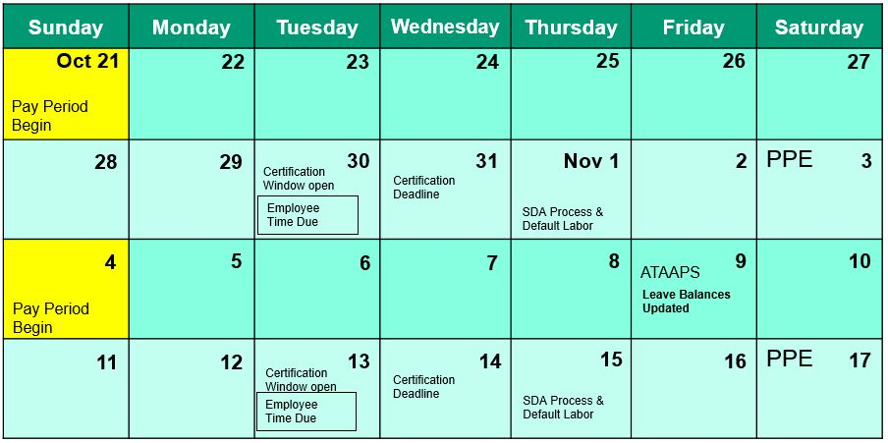
Pay Period Process
Check Calendar for Timeline Changes due to Holidays!

Slide 6
Employee

Slide 7
Agenda
Important Information
Employee Responsibilities
Leave Guidance AFI 36-815 & OPM
Leave Balances when LWOP/PCS/Resigning/Retiring
Timecard Correction
How to add a Reason/Purpose to Sick Leave/PF
Premium Requests
Concurrence of Timecard!

Slide 8
Important Information
Read emails that you receive from Civilian Pay
Follow Instructions and Timelines per Pay Period
CONCUR your timecard (your signature)
Request leave in advance (as soon as you plan it!)
Input timecard in advance before going on leave/TDY
If a reason is selected on a leave request it has to be added to the timecard
Check LES leave balances (some forfeits)
It’s your Pay!

Slide 9
Employee Responsibilities
Check your LES every pay period (leave balance, pay, deductions, etc.)
All actions associated with proper recording, adjusting & certifying time worked, absence and labor information
If unable to concur due to absence, concur on first duty day upon return!
Certification of T&A is an authorization for the expenditure of Government Funds

Slide 10
AFI36-815 & OPM
Sick Leave Reason Family Care (DE) max 104 h/year
FMLA only when invoked through CPO 480h/12 months
Physical Fitness (PF) up to 3 h/week max. 1.5 h/day
All leave always requires a leave request (except LH)

Slide 11
Annual Leave (LA)
Accrual 4/6/8 hours depending on service time
Carry over is 240 or 360 at leave year end -> hours in access show as Use or Lose
Use or Lose: current balance + year accrual = how much LA needs to be taken to not forfeit any at Leave Year End
Advanced Annual Leave (LB):
Max hours are accrual by end of leave year
Any advance upon separation will be indebted
No accrual when total of 80 h LWOP reached

Slide 12
Sick Leave (LS)
Accrual of 4 h per pay period
No accrual when total of 80 h LWOP reached
No limit of use for own personal medical needs
After 3 days medical documentation required
Family Care/Bereavement (DE) max of 104 h/13 days per leave year (counts towards FMLA 12 weeks)
Disabled Veteran (PW)
Advanced Sick Leave (LG) request/approved by CPO
Max 240 h (30 days) with medical documentation
Unplanned Sick only time leave request can be done after return

Slide 13
Family Medical Leave Act (FMLA)
Must have completed 12 months of service
Up to 480 h/12 weeks during 12 month period
Unpaid or paid leave for family and medical needs
Requested and approved by CPO
Time used for Family Care/Bereavement is deducted

Slide 14
LWOP (KA)
No leave accrual when total of 80 h KA is reached
Temporary non-pay status and absence from duty
Supervisor’s decision if LWOP is granted when paid leave is available

Slide 15
Military Leave (LM) for National Guard or Reserve
120 h/15 days per year (loaded in October every year)
Up to 120 h can be carried over (max. 240 h)
Time off at full pay for active/inactive duty
Return: submit a certified verification of attendance to Civilian Pay & HR
Failure to provide documents -> LM not authorized and paid/unpaid leave has to be charged

Slide 16
Admin Leave (LN)
Authorized absence from duty without loss of pay or charge to leave
Weather & Safety (Reason PS)
use for Weather dismissals when ordered
On German/NATO Holidays when facility/base is closed code T&A as LN
Leave Request always required (Remarks: NATO/Local Holiday)

Slide 17
Admin Leave Reason PF
Physical Fitness Agreement needs to be on file in Unit
Physical Fitness up to 3 h per week
Max per day 1.5 h
You must show up to work prior and after
Needs to be coded on T&A as LN Reason PF
Leave Request
No Premium Hours on same day authorized!

Slide 18
Time Off Award (LY)
Has to be used within 26 pay periods or will forfeit
Cannot be restored or paid
Commonly known as TOA

Slide 19
Home Leave (LK)
Accrual of 5/10/15 days per year
After 2 years of Service OCONUS (once during career)
Use only authorized in CONUS/Territorial Possessions
Have to return OCONUS
Balance on LES are in DAYS

Slide 20
Credit Hours (CD) Premium Hours
Max balance at end of pay period is 24 h
Excess hours will forfeit
Have to be used within 26 pay periods or will forfeit
Can’t be used before earned (even in same pay period)
Premium Request to earn (CD)
Leave Request to use (CN)

Slide 21
Travel Comp Time Premium Hours
Travel Time outside of Duty hours for TDY
Has to be used within 26 pay periods or will forfeit
Premium Request to earn (CB)
Leave Request to use (CF)

Slide 22
Comp Time (CE) Premium Hours
Has to be used within 26 pay periods
If not used paid at Overtime Rate when earned
Premium Request to earn (CE)
Leave Request to use (CT)

Slide 23
Holiday Premium Pay (HG/HF)
Working on US Holidays: HG/HF
T&A max is 8.0 h
Additional hours coded as RG
Leave cannot be charged on a holiday
Code T&A 8 h LH and 0.3 h LN for max-flex AWS

Slide 24
Leave balances when going on LWOP
Picked up for new position:
Annual & sick leave will transfer
TOA, (Travel) Comp Time will transfer if same Agency
Credit hours/Comp Time will pay if different Agency
Travel Comp Time forfeits if different Agency
Dropping from LWOP
Annual will pay lump sum
Sick leave can be reinstated if re-employed in federal service regardless of break in service time

Slide 25
Leave balances when PCS’ing
Annual/Sick/Home leave will transfer
TOA/(Travel) Comp Time will transfer if in same Agency
Credit hours/Comp Time will pay if different Agency
Travel Comp Time forfeits if different Agency

Slide 26
Leave balances when Resigning
Annual Leave/Credit Hours/Comp Time pay lump sum
Sick leave can be reinstated
TOA/Travel Comp Time forfeits

Slide 27
Leave balances when Retiring
Annual Leave/Credit Hours/Comp Time pay lump sum
Sick leave counts towards service time
TOA/Travel Comp Time forfeits

Slide 28
Premium Request
Every 15 Minutes on top of your Duty Time have to be Recorded via Premium Request
Overtime Scheduled – OS -> approved AF428 has to be on file then pays with PP earned at OS Rate (usually hours x 1.5)
Comp Time – CE
Travel Comp Time – CB
Credit Hours – CD

Slide 29
How to Use ATAAPS
ATAAPS Help Link teaches you everything you need to know about ATAAPS. If you are still in need of assistance please see your local timekeeper.
https://af.ataaps.csd.disa.mil/ataaps_AF3/help/Home.htm
Input Time:
Hover over Timekeeping, then Labor, then choose Modify Labor
Create Leave Request:
Hover over Timekeeping, then choose Leave Request

Slide 30
Certifier

Slide 31
Agenda
Important Information
Certifier Responsibilities
When an Employee is Unavailable
ATAAPS Error Flags
Records Maintenance
Termination of DD577
Request for Overtime, Holiday Premium Pay, and Compensatory Time (AF428)
AF36-815 & OPM -> Leave approval in advance! (see employee slides)

Slide 32
Important Information
Read emails that you receive from Civilian Pay
Follow Instructions and Timelines per Pay Period
Check Leave/Premium Requests when input
Check that Request actually matches labor reported
Check if PF time is used and coded properly
Ensure T&A is CONCURRED
Ensure T&A is done before going on leave/TDY
Don’t certify ERROR Flags (only in an emergency)
Check Notifications

Slide 33
Certifier Responsibilities
Annual Refresher of DAO101 Training to keep certifier rights
Certification: clear all ATAAPS error Flags prior to certifying
Review, approve/disapprove leave requests prior to certification
Leave/premium hours have to be approved in advance
Have direct knowledge of premium hours claimed
Review/ensure all leave codes are supported by proper docs
When going on leave ensure alternate is available!
Certification performed by alternate does NOT relieve from duty
Failure to adhere will result in suspension of access and report to appointing authority
Certification of T&A is an authorization for the expenditure of Government Funds

Slide 34
When employee is unavailable
If the employee is unavailable e.g. emergency leave
Contact timekeeper (if not available Civilian Pay)
Upon written acknowledgement by employees supervisor attesting actual T&A performed the timekeeper can update T&A in ATAAPS
Once T&A is updated time can be certified
Leave a comment!

Slide 35
ATAAPS Error Flags
Conflict between hours reported and supporting documentation:
Missing leave/premium request
Leave/premium request does not match labor reported 100%
Date, total hours, reason
All Error Flags must be cleared!
Only in emergencies:
Certification of an Error Flag authorized
LEAVE A COMMENT!

Slide 36
Records Maintenance
Maintain DD577, DAO Training Cert for 10 years after termination
Maintain DD2875 for 10 years after termination
Hardcopy Timecards for one year in Employee File

Slide 37
Termination of DD577
If you are no longer required to be a certifier you must terminate your DD577 in Section IV
Provide copies to Civilian Pay and the Timekeeper/ Secretary

Slide 38
Overtime/Comp Time/ Credit hours
If an employee is directed to stay late they have to be compensated with OS/OU/CE
Overtime (OS/OU) pays times 1.5
Comp Time (CE) available leave balance for 26 pay periods
If not used will pay at overtime rate when earned
Employees Salary under GS 10 Step 10 get to chose OS/CE
Salary Over GS 10 Step 10 can be directed to use Comp Time
Credit hours (CD) are voluntary!
Not payable, cannot be directed, can be approved by certifier, only require premium request in ATAAPS

Slide 39
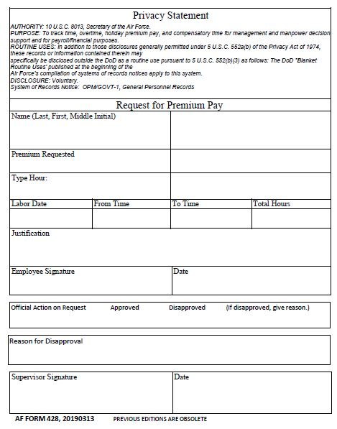
Request for Overtime, Holiday Premium Pay, and Compensatory Time (AF428)
When Overtime (OS/OU), Compensatory Time (CE) or Holiday Premium Pay (HG) is claimed on the timecard ensure that a:
ATAAPS: Premium Request must be requested & approved in ADVANCE
If you don’t have ATAAPS: AF428 must be requested & approved in ADVANCE

Slide 40
Request for Overtime, Holiday Premium Pay, and Compensatory Time (AF428) cont.
Per AFI36-808 Justification Statement is to include following:
Specific tasks to be accomplished
Reason(s) tasks could not be completed during regular work hours
Acknowledgement that other options were considered and found not to be appropriate prior to allowing overtime and annual leave in the same pay period, if applicable
AF428 Template link: https://static.e-publishing.af.mil/production/1/af_a1/form/af428/af428.pdf
Overtime may not be paid

Slide 41
Timekeeper

Slide 42
Agenda
Important Information
ATAAPS Timekeeper Responsibilities
Records Maintenance
DCPS Timekeeper Responsibilities

Slide 43
Important Information
Read emails that you receive about ATAAPS
FOLLOW INSTRUCTIONS and ENFORCE DEADLINE
Ensure T&A is CONCURRED
Ensure T&A is done before going on leave/TDY
Ensure ERROR Flags are cleared
Access requires: DD2875, KSM Letter, FOP 101, DAO 101 and Civilian Pay & ATAAPS Training

Slide 44
ATAAPS Timekeeper Responsibilities
Annual Refresher of DAO101 Training to keep Timekeeper rights
Ensure timecards are concurred & assigned hours are accounted
Ensure Error Flags are cleared
Review/ensure all leave codes are supported by proper docs
Input T&A for Employee (written acknowledgement from certifier)
Train Employees & Certifiers on ATAAPS
When going on leave ensure Alternate is available (inform CSR)!
Reports: Retro Uncertified Employees (corrected timecards pending to report)

Slide 45
Records Maintenance
Maintain documents for Employees, Timekeepers & Certifiers
Assist with DD577 Annual Review
Have Certifiers turn in terminated DD577 if no longer needed/PCS
Retention Periods:
DD577, DAO Certificate, DD2875 for 10 years after termination
Hardcopy Timecards & OPM71: 1 year in ERF
AF428: 6 years in ERF

Slide 46
DCPS Timekeeper Responsibilities
Avoid need for manual input of T&A in DCPS
Only by exception DCPS T&A input (determined by CC that hardship will occur)
If correction in ATAAPS possible a DCPS entry NOT warranted
Manual input: hardcopy must be signed by Certifier (DD577 & DAO101 on file)

Slide 47
References
OPM Leave Guidance
https://www.opm.gov/policy-data-oversight/pay-leave/leave-administration/#url=Fact-Sheets
AFI36-815
http://static.e-publishing.af.mil/production/1/af_a1/publication/afi36-815/afi36-815.pdf
AFI36-808
https://static.e-publishing.af.mil/production/1/af_a1/publication/dodi1400.25v550_afi36-808/dodi1400.25v550_afi36-808.pdf
Civilian Pay Business Rules 1 Aug 2016
ATAAPS Training Slides

Slide 48
Note:
Only required from Certifiers & Timekeepers!
Please input your name and date before you sign.
Can be digital (if printed as PDF) or wet signature.
Print out has to be set to COLOR!
Certificate of Completion
Civilian Pay & ATAAPS Training
Training Content:
timekeeper & Certifier responsibilities
Records maintenance
Specific bi-weekly payroll timelines
Replace with your Name!
I certify I have read and I understand the information presented in Civ pay & ataaps Training package
DAO’s Name and Signature
Date

