Slide 1
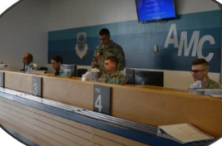
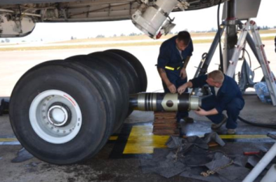
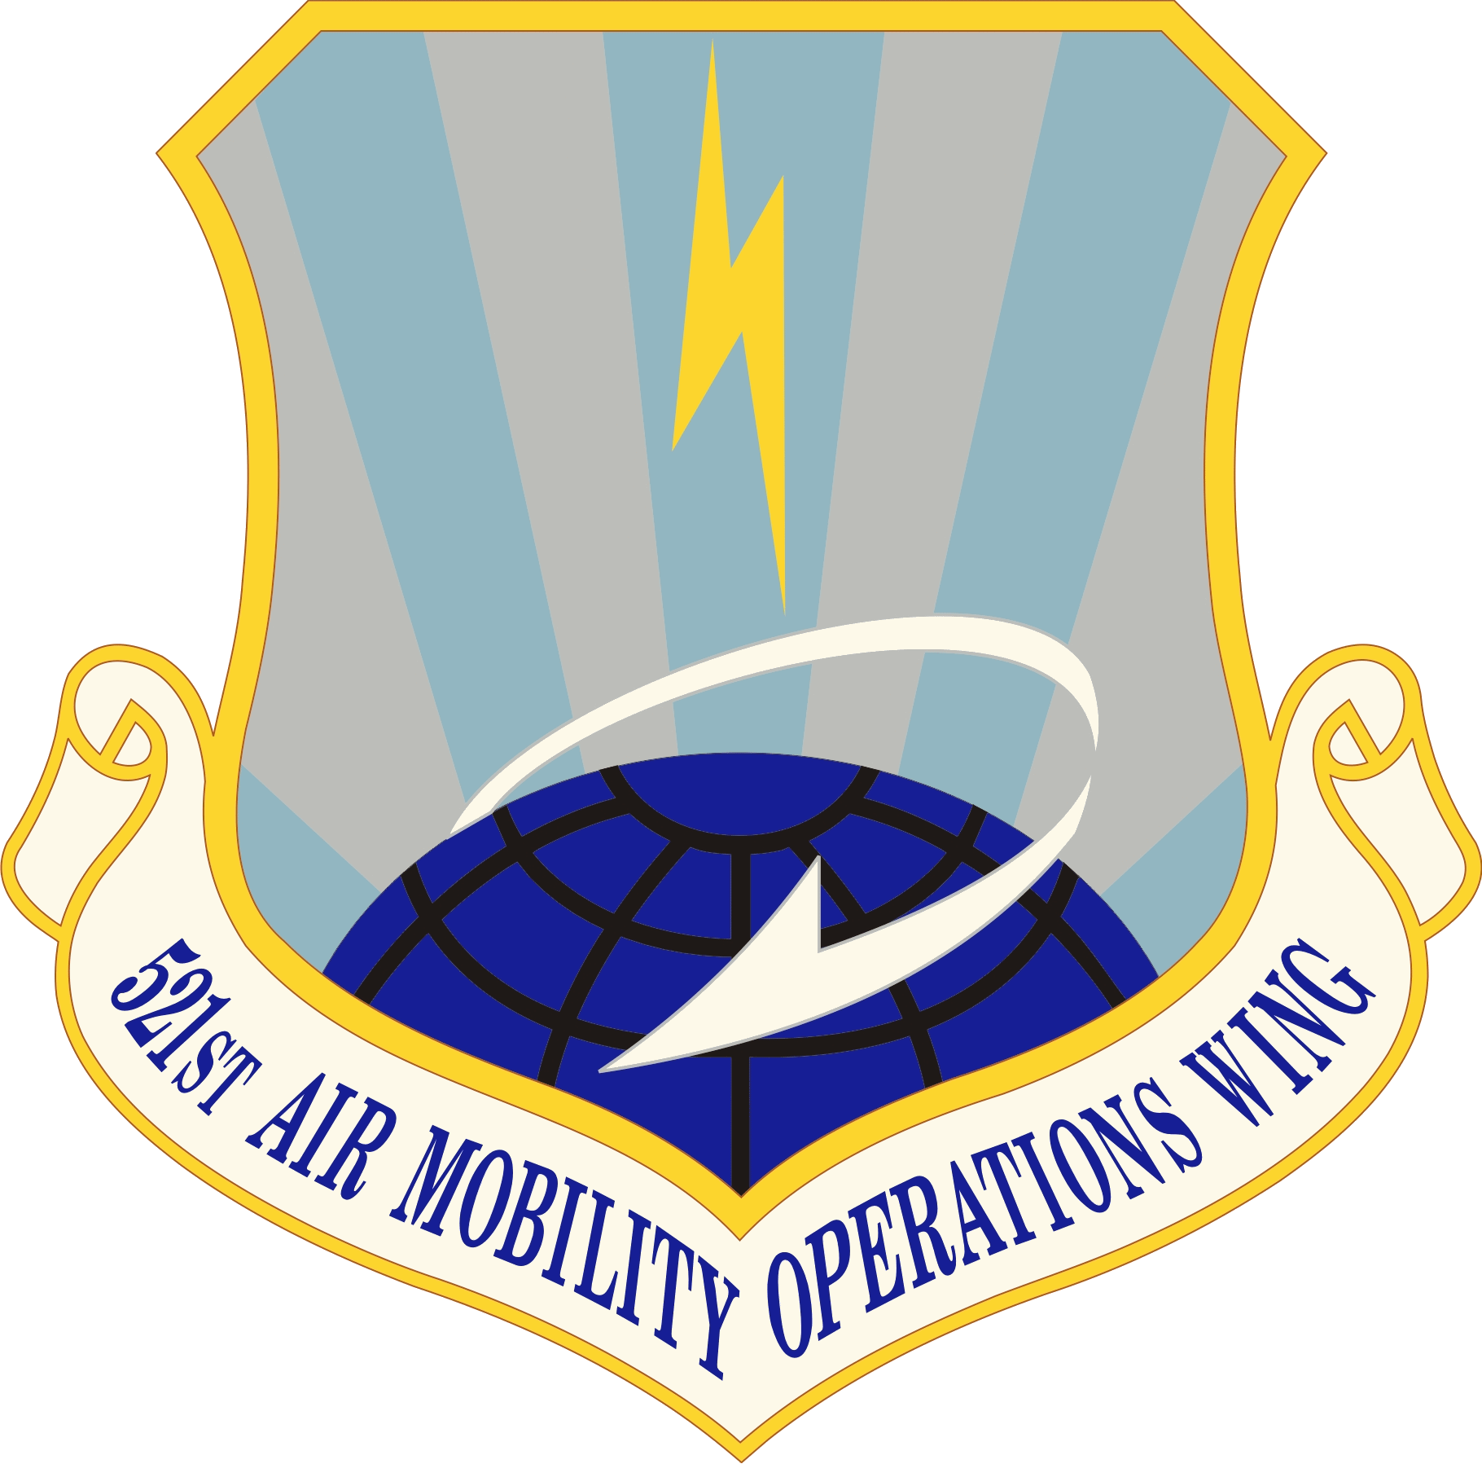
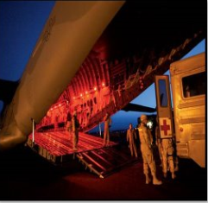
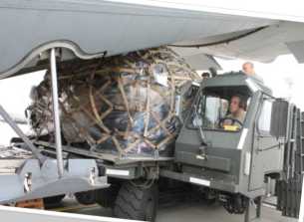
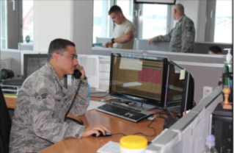
OPERATIONS
ANNUAL WORKLOAD (FY15)
DID YOU KNOW…
Integrity - Service - Excellence
HISTORY:
Originally established as an aircraft warning unit during World War II, the unit also provided communications support in England, in France following the D-Day invasion and during the occupation of Germany. After World War II, the wing provided radar coverage and navigational aid to aircraft flying in the US Zone of Occupied Europe and then provided tactical control systems that included aircraft control and warning facilities. Since 2008, the wing has provided “Rapid Global Mobility” by enabling US coalition air mobility throughout Europe, the Middle East and Africa, and by accelerating the delivery of war-fighting and humanitarian effects for the United States. This is done through the wings core competencies: aircraft maintenance, aerial port operations, aeromedical evacuation, command and control.
521st
Air Mobility Operations Wing
Flexibility, Tenacity, Velocity,
…DEPEND ON US!
Operation Inherent Resolve
Received and processed cargo and combat equipment to Incirlik
Operation Freedom’s Sentinel
Managed, maintained, and scheduled 30 C-17 aircraft and aircrew in support of the operation.
Operation United Assistance
Passenger and cargo handling for missions originating out of Western Africa. Provided Ebola kits for transitioning the “hot zone”
Operation Odyssey Dawn
C2 node during initiation and execution of Coronet missions
Operation Enduring Freedom
10.5K departures/719K PAX/347K cargo
Operation Iraqi Freedom
Provided command & control, aerial port operations, aircraft maintenance & aeromedical evacuation
Missions: 60,743
Passengers: 592,775
Cargo (tons): 164,071
Aeromedical Evacuations: 284
Aircraft Fleeted: 36,869
We span 3 continents, 6 time zones and 5,000 miles
We provide beds, beans and bullets to 5 CCMDs
(AFRICOM, CENTCOM, EUCOM/SOCOM, and TRANSCOM)
We touch over 30% of AMC’s world-wide cargo
We provide access to 64% of the nations in the world
We service 26% of all DoD airlift
We enabled record breaking C-5M stage with 25M lbs moved w/ 91% in commission rate
And much more…
See us on:
https://ice.usafe.af.mil/sites/521AMOW/default.aspx
https://www.facebook.com/521amow

Slide 2
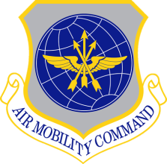









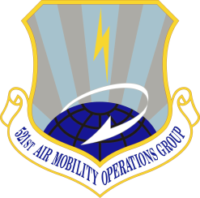
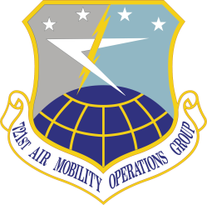
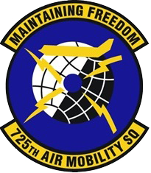
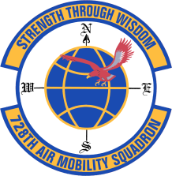


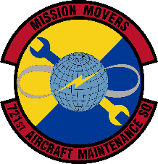
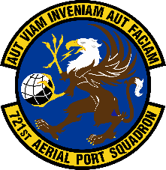
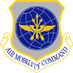
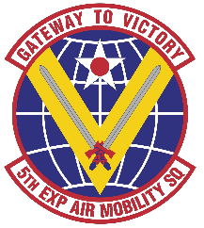
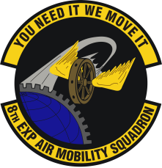


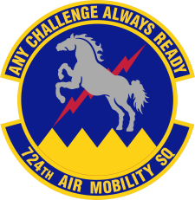


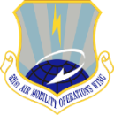
521st Air Mobility Operations Wing
Mission
Expedite Global Reach with
En Route Professionals in
Answering Our Nation’s Call
Core Competencies
Command and Control
Aeromedical Evacuation
Aircraft Maintenance
Aerial Port Operations
Vision
Bold Airmen…Shaping AMC’s Premier
En Route for Tomorrow
CHAIN OF COMMAND
Rota, Spain
Ramstein, Germany
UNITED STATES
TRANSPORTATION
COMMAND
AIR
MOBILITY
COMMAND
Rota, Spain
Incirlik, Turkey
Ramstein, Germany
Ramstein, Germany
Ramstein, Germany
USAF
EXPEDITIONARY
CENTER
18TH
AIR
FORCE
521ST
AIR MOBILITY
OPERATIONS WING
Kuwait
Al Udeid, Qatar
Aviano, Italy
Spangdahlem, Germany
Mildenhall, UK

